Slide 1


Defining the Project
(25CPE4602)
Lecture 4

Slide 2
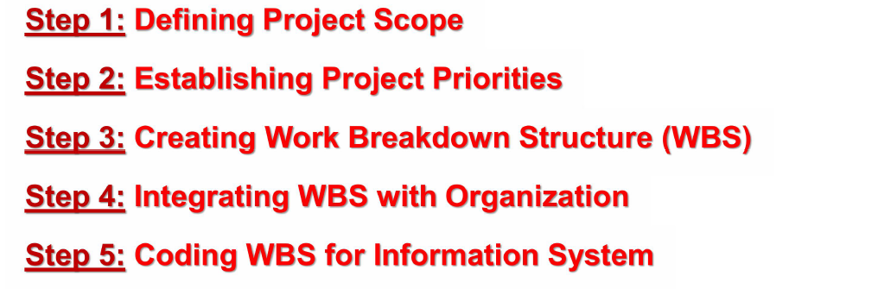
Five general steps for collecting project information

Slide 3
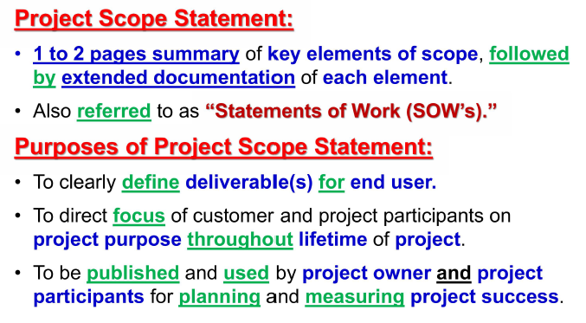
Step 1: Defining project scope
Notes:
The project scope statement is a detailed outline that includes a timeline, budget, assigned tasks, project stakeholders, and workflow strategies.
With a well-defined project plan and project scope statement, project managers can easily oversee each step in the project’s delivery. The scope statement keeps contributors on task, within budget, and on track to meet deadlines.
Team leaders should also map out a procedure for project changes within the scope statement. If a change is needed, stakeholders should inform the team and follow the guidance in the project scope statement to ensure a minimal impact.
Problem Scope Statement
Project Title: Improving Customer Satisfaction in Online Retail
Background
Customer satisfaction is critical to the success of our online retail business. Recent surveys indicate a decline in customer satisfaction over the past six months, primarily related to product delivery times and customer service responsiveness.
Problem Statement
Customers have reported dissatisfaction due to prolonged delivery times (average of 7 days) and inadequate responses from customer service (average response time of 48 hours). This issue has led to a 15% decrease in repeat purchases.
Objectives
Analyze current logistics and customer service processes.
Identify key bottlenecks contributing to delivery delays.
Develop strategies to enhance customer service response times.
Scope
In-Scope:
Review of current logistics providers and delivery methods.
Assessment of customer service protocols and staffing.
Implementation of new tracking systems for delivery.
Out-of-Scope:
Changes to product offerings or pricing.
Marketing strategies unrelated to customer service improvements.
Deliverables
A report detailing findings from the analysis.
Recommendations for logistics improvements.
A plan for enhancing customer service training.
Timeline
The project will be initiated on [Start Date] and is expected to be completed by [End Date], with regular updates provided to stakeholders.
Stakeholders
Project Manager
Logistics Team
Customer Service Team
Marketing Department
This example highlights the problem, objectives, scope, and deliverables clearly, providing a structured approach to addressing the issue at hand.
Problem Scope Statement
Project Title: Enhancing Network Security for Company Infrastructure
Background
With the increase in cyber threats, our company’s network security has become a pressing concern. Recent assessments have revealed vulnerabilities in our existing firewall and intrusion detection systems, potentially exposing sensitive data to unauthorized access.
Problem Statement
The current network security infrastructure is inadequate to defend against advanced persistent threats (APTs) and has resulted in multiple security incidents over the past year. These vulnerabilities could lead to data breaches, resulting in financial loss and reputational damage.
Objectives
Conduct a comprehensive security audit of the existing network infrastructure.
Identify vulnerabilities and gaps in the current firewall and intrusion detection systems.
Propose and implement enhanced security measures to protect sensitive data.
Scope
In-Scope:
Assessment of existing firewall configurations and rules.
Evaluation of intrusion detection and prevention systems.
Implementation of upgraded security protocols and tools.
Out-of-Scope:
Changes to non-network related systems (e.g., application software).
Employee training programs not directly related to security measures.
Deliverables
A detailed report of the security audit findings.
A list of identified vulnerabilities and recommended solutions.
An implementation plan for enhanced security measures, including timelines.
Timeline
The project is scheduled to commence on [Start Date] and will conclude by [End Date], with bi-weekly progress updates provided to the IT department and stakeholders.
Stakeholders
IT Security Team
Network Engineering Team
Compliance Officer
Upper Management
This example clearly defines the problem related to network security, the objectives to be achieved, and the scope of the project, ensuring all stakeholders are aligned on the project goals.
Problem Scope Statement
Project Title: Optimizing Database Performance for E-Commerce Platform
Background
Our e-commerce platform has experienced slower database response times, particularly during peak shopping periods. This has led to increased page load times and a decline in user satisfaction, ultimately affecting sales.
Problem Statement
The current database performance is inadequate, with average query response times exceeding 2 seconds during high traffic. This inefficiency has resulted in a 20% increase in cart abandonment rates over the last quarter.
Objectives
Analyze the current database architecture and query performance.
Identify inefficiencies in database indexing and query optimization.
Implement changes to improve overall database response times.
Scope
In-Scope:
Review of existing database schema and indexing strategies.
Assessment of query performance and execution plans.
Implementation of optimizations and performance tuning.
Out-of-Scope:
Changes to the application layer or user interface.
Migration to a different database management system (DBMS).
Deliverables
A comprehensive report detailing performance analysis and identified issues.
Recommendations for database optimization, including indexing strategies.
A timeline and plan for implementing performance improvements.
Timeline
The project is expected to start on [Start Date] and be completed by [End Date], with weekly updates provided to the development team and project stakeholders.
Stakeholders
Database Administrators
Software Development Team
Product Management
Customer Support Team
This example outlines the problem of database performance in an e-commerce context, clearly defining the objectives, scope, and expected deliverables to align all involved parties.

Slide 4
Why is defining project scope important in project management?
A clear project scope:
Provides a roadmap. Any team member can refer to the project scope at any point during the project for alignment and a clear view of project goals.
Manages stakeholder expectations. Stakeholders may have different priorities for the project. The project scope sets the parameters, ensuring everyone knows the specific intentions and goals.
Makes budgeting and scheduling easier. Defining deadlines and constraints in the project scope before beginning helps you plan resources.
Prevents scope creep. Setting the boundaries of your project in the project scope helps alleviate issues that may shift the focus of your project away from the plan.
Notes:
Defining and documenting project scope is crucial for keeping contributors aligned. It outlines significant limitations and constraints that may derail timelines, budgets, and deliverables. Defining these parameters of a project helps alleviate unforeseen issues.
Determining which results to measure when defining project scope, like costs or conversion rate, is essential. Then, discuss the team’s vision and allow project managers (PMs) to create compromise by diagnosing areas of concern or disagreement. This helps you understand the project's goals and how each team can contribute.
A clear project scope:
Provides a roadmap. Any team member can refer to the project scope at any point during the project for alignment and a clear view of project goals.
Manages stakeholder expectations. Stakeholders may have different priorities for the project. The project scope sets the parameters, ensuring everyone knows the specific intentions and goals.
Makes budgeting and scheduling easier. Defining deadlines and constraints in the project scope before beginning helps you plan resources.
Prevents scope creep. Setting the boundaries of your project in the project scope helps alleviate issues that may shift the focus of your project away from the plan.

Slide 5
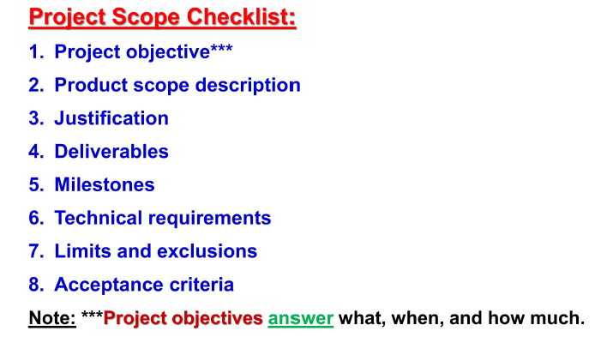
How to define project scope step-by-step?

Slide 6
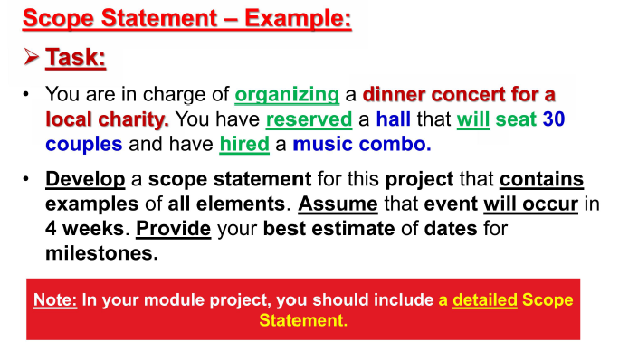
Scope statement – example

Slide 7
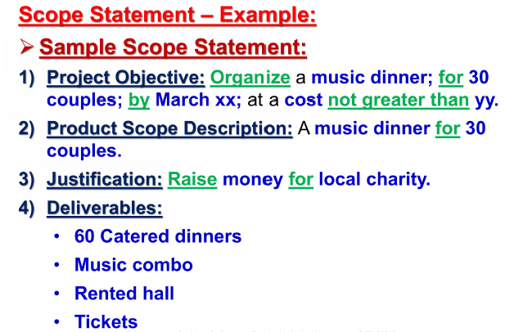

Slide 8
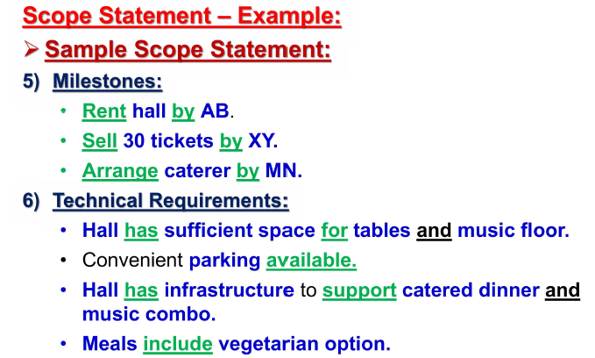

Slide 9
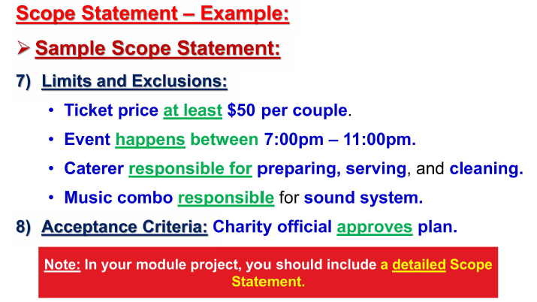

Slide 10
More Project scope examples
Here are a few examples of how project scope can be defined for different types of projects:
Website development project.
Objectives: Increase website traffic by 20%, improve user engagement by 15%, and generate 10% more leads.
Deliverables: Redesigned website with improved user interface, new content, and enhanced functionality.
Exclusions: Mobile app development and social media marketing campaign.
Constraints: Budget of $50,000, a timeline of 3 months.
Product launch.
Objectives: Successfully launch a new product to market, achieve a 5% market share within the first year, and generate $1 million in revenue.
Deliverables: Product development, marketing campaign, sales training, and launch event.
Exclusions: Post-launch customer support and product enhancements.
Constraints: Timeline of 6 months, budget of $250,000.
Internal process improvement project.
Objectives: Streamline a specific internal process, reduce processing time by 10%, and improve efficiency by 15%.
Deliverables: Process mapping, gap analysis, recommendations for improvement, and implementation plan.
Exclusions: Technology upgrades, employee training.
Constraints: Timeline of 2 months, budget of $10,000.
Notes:
Project scope outline.
Every project scope statement should follow a consistent outline. Below is a basic outline and an example of what each section might look like.
Introduction.
The introduction should define the purpose, goal, and stakeholders and give a high-level overview of the project’s scope. An introductory statement might start with, “This marketing project is being undertaken to create an article to post on the blog to create brand awareness.”
Project scope requirements and goals.
The project scope is the main piece of the project scope statement. It should define specific requirements like budget, timeline, or contributing teams. You can also offer a vision of the deliverables.
Include a statement like, “This project will include research, content strategy, content creation, and content publication on the company blog. It will also include sharing the article on social media. The marketing team will conduct all activities.”
Deliverables.
Define the item that needs to be completed, who it’s going to, and any deadlines. It is crucial to create parameters around deliverables so that the expected result is straightforward and doesn’t lead to churn. For example, a short write-up could say, “Project deliverables include one researched, written article of up to 1,000 words to be delivered by email.”
Project acceptance criteria.
Use acceptance criteria to set target thresholds for your project requirements. Be sure to state who will be responsible for the final analysis and how the metrics will be measured. In the project outline, you might begin with something like, “The company will review and approve the final article before publishing.”
Exclusions.
List the components that will not be a part of the project. It is essential to get alignment from team members and leaders to clarify expectations. Identify these in writing before beginning the work. For example, your statement might include, “This project will not include payment to external vendors for research or outsourced services.”
Constraints.
Document project constraints like budget limits or timeframes. To clearly state the potential sources of scope creep, your statement could say, “Constraints may include communication delays, changes in scope, or technical difficulties. The budget for this project is $21,000, and it must be completed by the end of Q3.”
Change control process.
Clearly define the steps required to alter the project scope and who should be involved in any changes. The change control process in your project scope statement may read, “Any modifications to the project should be submitted to the project manager, who will assess the request and approve or deny it. Necessary stakeholders should also be included in the initial request.”

Slide 11
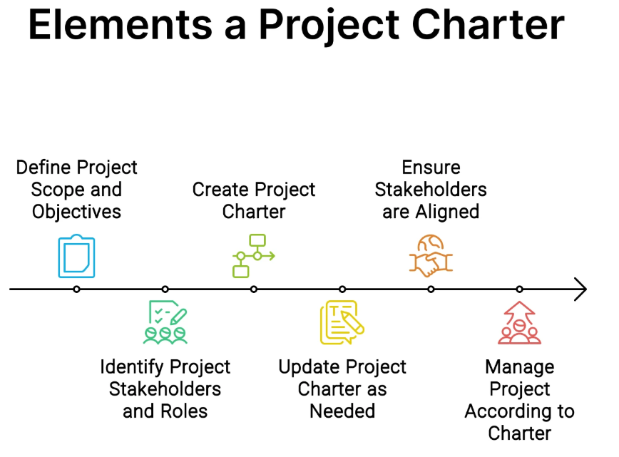
Project charter
Some companies refer to scope statements as “statements of work” (SOW).
A project charter:
Refers to a document that authorizes the project manager to initiate and lead the project.
This document is issued by upper management and provides the project manager with written authority to use organizational resources for project activities.
Often the charter will include a brief scope description as well as such items as risk limits, business case, spending limits, and even team composition.
2
Notes:
While the specific elements of a project charter may vary based on the project methodology and organizational standards, most project charters typically include the following key components:
Project Objectives and Benefits
This section outlines the overarching goals and desired outcomes of the project. It should clearly articulate the purpose, expected benefits, and how success will be measured (project success criteria). Well-defined objectives provide a shared understanding of what the project aims to accomplish.
Project Scope, one of the Elements of a Project Charter
The scope statement delineates the boundaries of the project, specifying what will be included (deliverables) and what falls outside the scope (constraints). It helps manage expectations and prevents scope creep, which can derail projects. The scope should align with the stated objectives.
Project Milestones and Timeline
This section outlines the major milestones, deadlines, and a high-level project schedule. It sets expectations for when key deliverables will be completed and provides a roadmap for tracking progress.
Project Stakeholders
Identifying and defining the roles of key stakeholders, including the project sponsor, project manager, core team members, and other impacted parties, is crucial. This section clarifies responsibilities and establishes lines of communication and decision-making authority.
Project Assumptions and Risks as one of the Elements of a Project Charter
All projects involve assumptions (e.g., resource availability, technology requirements) and potential risks that could impact success. Documenting these upfront allows for proactive risk management and contingency planning.
Project Budget and Resources
This section outlines the estimated budget, including costs for personnel, materials, equipment, and other expenses. It also specifies the required human resources, subject matter experts, and any special skills or training needed.
Project Governance, one of the Elements of a Project Charter
The governance model defines the project’s decision-making hierarchy, escalation paths, change control processes, and quality assurance measures.
Those with Six Sigma certification will recognize the governance model’s alignment with DMAIC (Define, Measure, Analyze, Improve, Control) principles, ensuring rigorous quality control.
Creating a Project Charter
Creating a comprehensive project charter is crucial for the success of any project. It serves as a formal document that establishes a partnership between the project team and key stakeholders. Here are the typical steps involved in creating an effective project charter:
Define Project Purpose and Justificatio

Slide 12
Creating a Project Charter
Here are the typical steps involved in creating an effective project charter:
1. Define Project Purpose and Justification
The first step is to clearly articulate the purpose and justification for initiating the project.
2. Establish Project Scope
Outline the major deliverables, requirements, constraints, and boundaries of the project.
3. Identify Key Stakeholders, one of the Elements of a Project Charter Creation
Determine all the people or groups that have an interest in or will be impacted by the project
4. Define Roles and Responsibilities
Clearly assign roles such as project manager, team members, advisors, decision-makers, etc., and delineate their respective responsibilities. This ensures accountability and avoids confusion later.
5. Estimate Time-frame and Budget
Provide a realistic timeline with major milestones and deadlines based on the project scope. Also, estimate the total budget required including costs for labor, materials, equipment, etc.
6. Analyze Risks and Assumptions, one of the Elements of a Project Charter
Identify potential risks that could impact the project along with mitigation strategies. Document any assumptions being made about resources, environment, constraints, etc.
7. Obtain Approvals
Once drafted, the project charter needs formal approval and sign-off from the project sponsor, key stakeholders, and governance bodies. Their commitment is critical for successful execution.
Notes:
Creating a comprehensive project charter is crucial for the success of any project. It serves as a formal document that establishes a partnership between the project team and key stakeholders. Here are the typical steps involved in creating an effective project charter:
Define Project Purpose and Justification
The first step is to clearly articulate the purpose and justification for initiating the project. This includes describing the business needs, problems or opportunities addressed, expected benefits, and strategic alignment with organizational goals.
Establish Project Scope
Outline the major deliverables, requirements, constraints, and boundaries of the project. The scope statement defines what is included and excluded from the project to manage expectations and prevent scope creep.
Identify Key Stakeholders, one of the Elements of a Project Charter Creation
Determine all the people or groups that have an interest in or will be impacted by the project. This includes the project sponsor, customers, subject matter experts, and any others who need to be consulted or informed.
Define Roles and Responsibilities
Clearly assign roles such as project manager, team members, advisors, decision-makers, etc., and delineate their respective responsibilities. This ensures accountability and avoids confusion later.
Estimate Time-frame and Budget
Provide a realistic timeline with major milestones and deadlines based on the project scope. Also, estimate the total budget required including costs for labor, materials, equipment, etc.
Analyze Risks and Assumptions, one of the Elements of a Project Charter
Identify potential risks that could impact the project along with mitigation strategies. Document any assumptions being made about resources, environment, constraints, etc.
Obtain Approvals
Once drafted, the project charter needs formal approval and sign-off from the project sponsor, key stakeholders, and governance bodies. Their commitment is critical for successful execution.

Slide 13
Scope creep
Scope creep
is the tendency for the project scope to expand over time;
usually by changing requirements, specifications, and priorities.
Scope creep can be reduced by carefully writing your scope statement.
A scope statement that is too broad is an invitation for scope creep.
Scope creep can have a positive or negative effect on the project.
If the project scope needs to change, it is critical to have a sound change control process in place that records the change and keeps a log of all project changes.
The log identifies the change, impact, and those responsible for accepting or rejecting a proposed change.

Slide 14
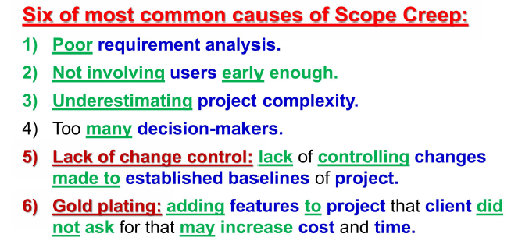
Six of most causes of scope creep:

Slide 15
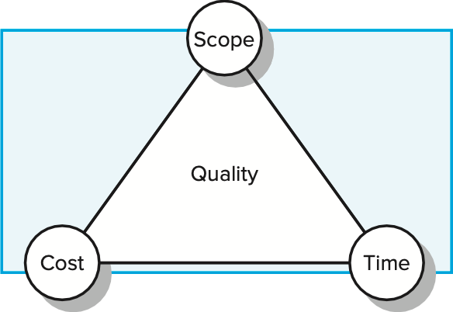
2- Establishing Project Priorities
The quality and the ultimate success of a project are traditionally defined as meeting and/ or exceeding the expectations of the customer and/or upper management in terms of cost (budget), time (schedule), and performance (scope) of the project.
One of the primary jobs of a project manager is to manage the trade-offs among time, cost, and performance. To do so, project managers must define and understand the nature of the priorities of the project through a candid discussion with the project customer and upper management.
3

Slide 16
Priority matrix (1/3)
A technique for the project to identify which criterion is constrained, which should be enhanced, and which can be accepted.
Constrain: The original parameter is fixed. The project must meet the completion date, specifications and scope of the project, or budget.
Enhance: Given the scope of the project, which criterion should be optimized? In the case of time and cost, this usually means taking advantage of opportunities to either reduce costs or shorten the schedule. Conversely, with regard to performance, enhancing means adding value to the project.
Accept: For which criterion is it tolerable not to meet the original parameters? When trade-offs have to be made, is it permissible for the schedule to slip, to reduce the scope and performance of the project, or to go over budget?
4

Slide 17
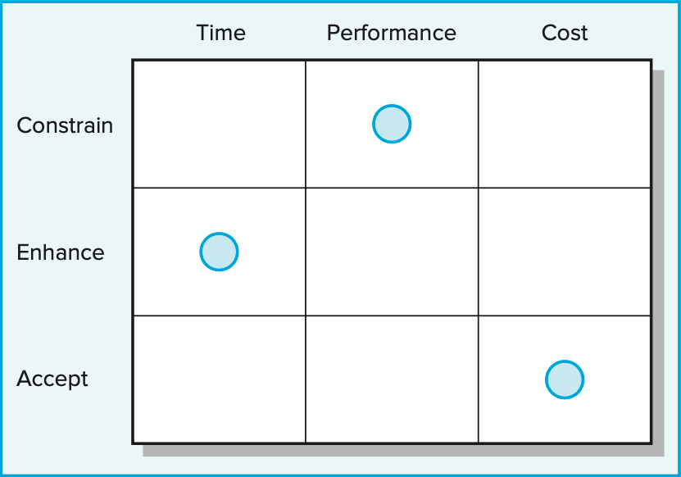
Priority matrix (2/3)
Example: development of a new wireless router.
Because time to market is important to sales, the project manager is instructed to take advantage of every opportunity to reduce completion time.
In doing so, going over budget is acceptable though not desirable.
At the same time, the original performance specifications for the modem as well as reliability standards cannot be compromised.

Slide 18
Priority matrix (3/3)
For many software projects, time to market is critical, and companies like Microsoft may defer original scope requirements to later versions in order to get to the market first.
Alternatively, for special event projects (conferences, parades, tournaments), time is constrained once the date has been announced, and if the budget is tight, the project manager will compromise the scope of the project in order to complete the project on time.
There are likely to be natural limits to the extent managers can constrain, optimize, or accept any one criterion. Some project managers document these limits as part of creating the priority matrix.

Slide 19
Example: Designing new IPhone
 | Time | Cost | Performance
Constrain
Enhance
Accept

Slide 20
3- Creating the Work Breakdown Structure (WBS)
Definition: WBS is an outline of the project with different levels of detail; where the work of the project can be successively subdivided into smaller and smaller work elements with its details.
It defines all the elements of the project in a hierarchical framework and establishes their relationships to the project end item(s)
Use of a WBS helps to assure project managers that all products and work elements are identified, to integrate the project with the current organization, and to establish a basis for control
Notes:
Components of WBS
Levels of Breakdown:
Level 1: Project Title (e.g., "Annual Conference")
Level 2: Major Deliverables (e.g., "Venue Selection", "Agenda Development", etc.)
Level 3: Sub-deliverables or Tasks (e.g., "Research Venues", "Identify Speakers", etc.)
Level 4: Work Packages (e.g., "Contact Venue A" or "Create Speaker Checklist")
Work Packages:
The lowest level of the WBS where tasks are defined in detail. Work packages are the activities that can be assigned to team members.
Milestones:
Key points in the project timeline that indicate significant progress (e.g., completion of venue selection).
Importance of WBS
Scope Definition:
Clearly delineates project scope and objectives, reducing the risk of scope creep.
Resource Allocation:
Helps identify required resources (human, financial, etc.) for each task, facilitating better budgeting and scheduling.
Task Management:
Breaks complex projects into manageable tasks, making it easier to assign responsibilities and track progress.
Risk Management:
Identifies potential risks associated with each task, enabling proactive risk management strategies.
Improved Communication:
Provides a visual representation of the project, making it easier to communicate with stakeholders.
Best Practices for Creating a WBS
Involve the Team:
Engage team members in the WBS creation process to ensure all perspectives are considered.
Use Clear and Consistent Naming:
Ensure that task names are descriptive and consistent throughout the WBS.
Follow the 100% Rule:
Ensure that the WBS captures 100% of the project deliverables, including project management tasks.
Keep It Simple:
Avoid overly complex structures; aim for clarity and simplicity.
Review and Revise:
Regularly review the WBS as the project evolves and make necessary adjustments.
Example of WBS in Detail
Let’s expand the previous conference planning example into a more detailed WBS:
Annual Conference Planning
1.1 Venue Selection
1.1.1 Research Venues
1.1.1.1 Identify Potential Venues
1.1.1.2 Gather Venue Specifications (capacity, amenities)
1.1.2 Site Visits
1.1.2.1 Schedule Visits
1.1.2.2 Evaluate Venues (notes, photos)
1.1.3 Contract Negotiation
1.1.3.1 Draft Contract Terms
1.1.3.2 Finalize Agreement
1.2 Agenda Development
1.2.1 Identify Speakers
1.2.1.1 Create Speaker Criteria
1.2.1.2 Send Invitations
1.2.2 Schedule Sessions
1.2.2.1 Create Draft Schedule
1.2.2.2 Confirm Session Times
1.2.3 Prepare Materials
1.2.3.1 Create Presentation Templates
1.2.3.2 Print Handouts
1.3 Marketing and Promotion
1.3.1 Design Promotional Materials
1.3.1.1 Develop Brochure
1.3.1.2 Create Social Media Graphics
1.3.2 Social Media Campaign
1.3.2.1 Develop Campaign Plan
1.3.2.2 Schedule Posts
1.3.3 Email Invitations
1.3.3.1 Design Email Template
1.3.3.2 Compile Email List
1.4 Registration Management
1.4.1 Setup Online Registration
1.4.1.1 Choose Registration Software
1.4.1.2 Create Registration Form
1.4.2 Monitor Registrations
1.4.2.1 Track Registrant Data
1.4.2.2 Follow Up with Registrants
1.4.3 Prepare Registration Packs
1.4.3.1 Compile Materials
1.4.3.2 Organize Distribution
Conclusion
A well-structured WBS is critical for successful project management. It enhances understanding, planning, and communication within the project team and with stakeholders, thereby increasing the likelihood of project success. By following best practices and involving the entire team, you can create an effective WBS that serves as a roadmap for your project.

Slide 21
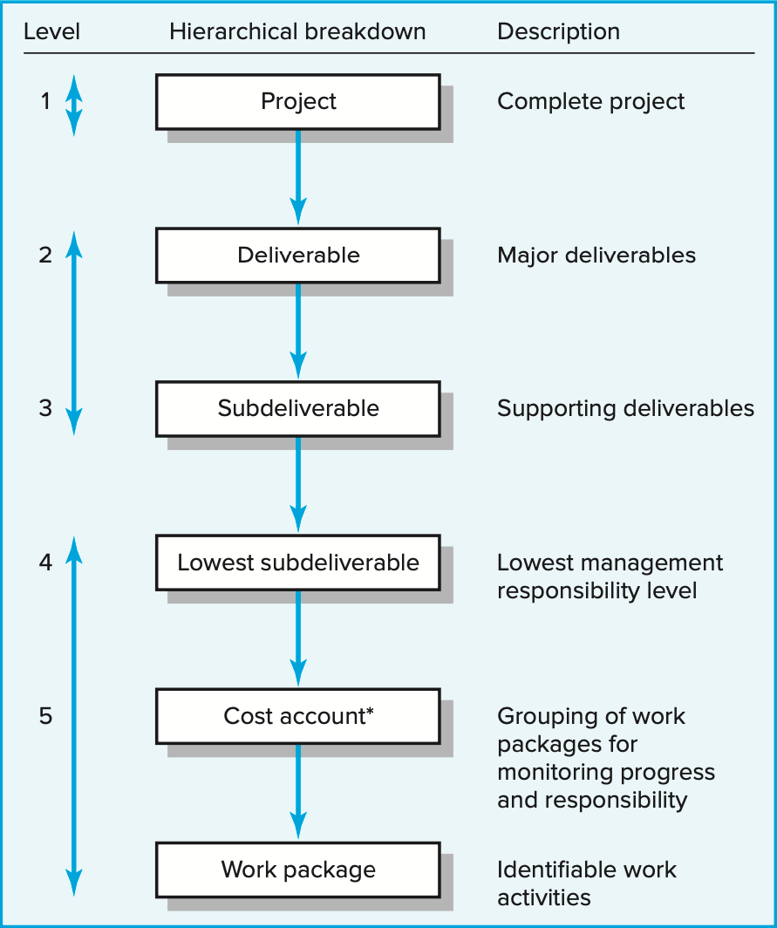
3- Creating the Work Breakdown Structure (WBS)
WBS begins with the project as the final deliverable. Major project work deliverables/systems are identified first; then the subdeliverables necessary to accomplish the larger deliverables are defined. The process is repeated until the subdeliverable detail is small enough to be manageable and where one person can be responsible. This subdeliverable is further divided into work packages.
Because the lowest subdeliverable usually includes several work packages, the work packages are grouped by type of work. For example, design and testing. These groupings within a subdeliverable are called cost accounts. This grouping facilitates a system for monitoring project progress by work, cost, and responsibility.
9
* This breakdown groups work packages by type of work within a deliverable and allows assignment of responsibility to an organizational unit. This extra step facilitates a system for monitoring project progress

Slide 22
3- Creating the Work Breakdown Structure (WBS)
This hierarchical structure facilitates evaluation of cost, time, and technical performance at all levels in the organization over the life of the project.
WBS also provides management with information appropriate to each level. For example, top management deals primarily with major deliverables, while first-line supervisors deal with smaller subdeliverables and work packages.
Each item in the WBS needs a time and cost estimate. With this information, it is possible to plan, schedule, and budget your project. The WBS also serves as a framework for tracking cost and work performance.
As the WBS is developed, organizational units and individuals are assigned responsibility for executing work packages. This integrates the work and the organization.
The WBS can also be used to define communication channels and assist in understanding and coordinating many parts of the project. Problems can be quickly addressed and coordinated because the structure integrates work and responsibility.
10

Slide 23
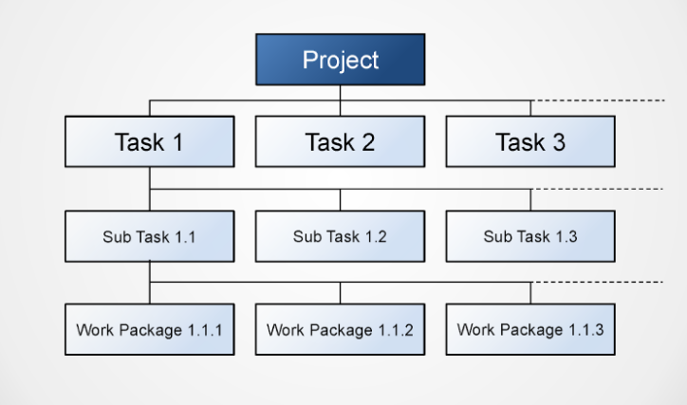
3- Creating the Work Breakdown Structure (WBS)

Slide 24
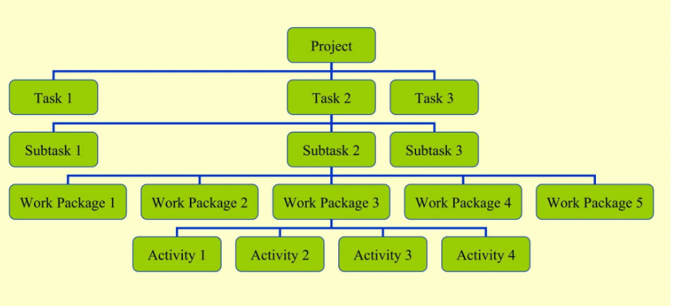
3- Creating the Work Breakdown Structure (WBS)

Slide 25
Levels of Breakdown in (WBS)
Hierarchical Structure
The WBS follows a hierarchical structure, where:
Level 1 contains the overall project.
Level 2 consists of major deliverables that contribute to the project.
Level 3 includes tasks that need to be completed for each deliverable.
Level 4 details the specific actions required to achieve those tasks.
Notes:
Benefits of Each Level
Level 1 (Project Title):
Provides a clear focus for the entire project.
Level 2 (Major Deliverables):
Helps in understanding the key components that need to be delivered for project success.
Level 3 (Sub-deliverables):
Allows for better planning and management of tasks by breaking down larger objectives into smaller actions.
Level 4 (Work Packages):
Facilitates detailed resource allocation and task assignment, ensuring accountability and clarity in responsibilities.

Slide 26
Levels of Breakdown in (WBS)
Level 1: Project Title
Description: This is the highest level of the WBS and represents the entire project or program. It encapsulates the project's overall goal and vision.
Example: "Annual Conference Planning“
Level 2: Major Deliverables
Description: This level includes the primary components or deliverables of the project. These are significant milestones that contribute directly to the project's objectives.
Examples:
  "Venue Selection"
  "Agenda Development"
  "Marketing and Promotion"
  "Registration Management"

Slide 27
Levels of Breakdown in (WBS)
Level 3: Sub-deliverables or Tasks
Description: This level breaks down the major deliverables into smaller, more manageable components. Each sub-deliverable typically corresponds to a specific area of work that needs to be accomplished to achieve the major deliverable.
Examples:
  Under "Venue Selection":
    "Research Venues"
    "Site Visits"
    "Contract Negotiation"
  Under "Agenda Development":
    "Identify Speakers"
    "Schedule Sessions"

Slide 28
Levels of Breakdown in (WBS)
Level 4: Work Packages
Description: This is the most detailed level of the WBS. Work packages are specific tasks or activities that can be assigned to team members. Each work package should have a clear output, duration, and assigned resources.
Examples:
  Under "Research Venues":
    "Identify Potential Venues"
    "Gather Venue Specifications"
  Under "Identify Speakers":
    "Create Speaker Criteria"
    "Send Invitations"

Slide 29
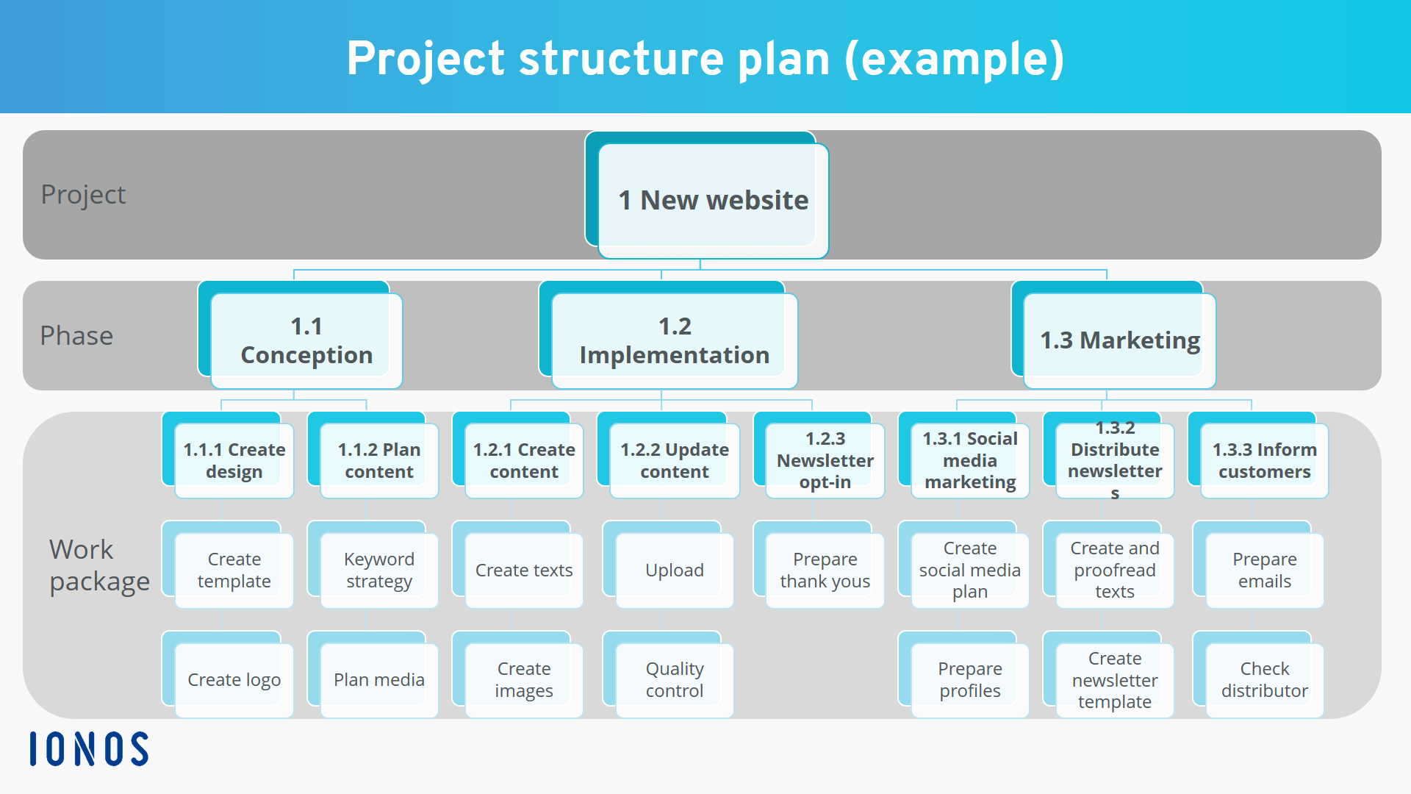
Example 1:

Slide 30
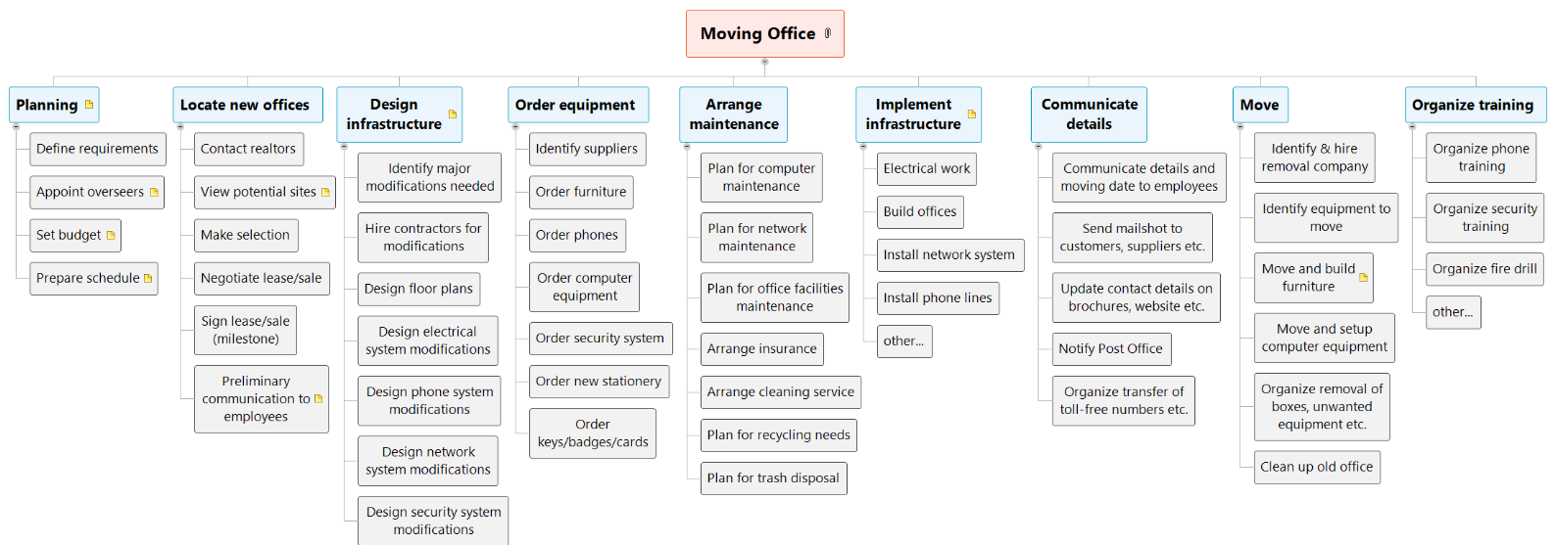
Example 2:

Slide 31
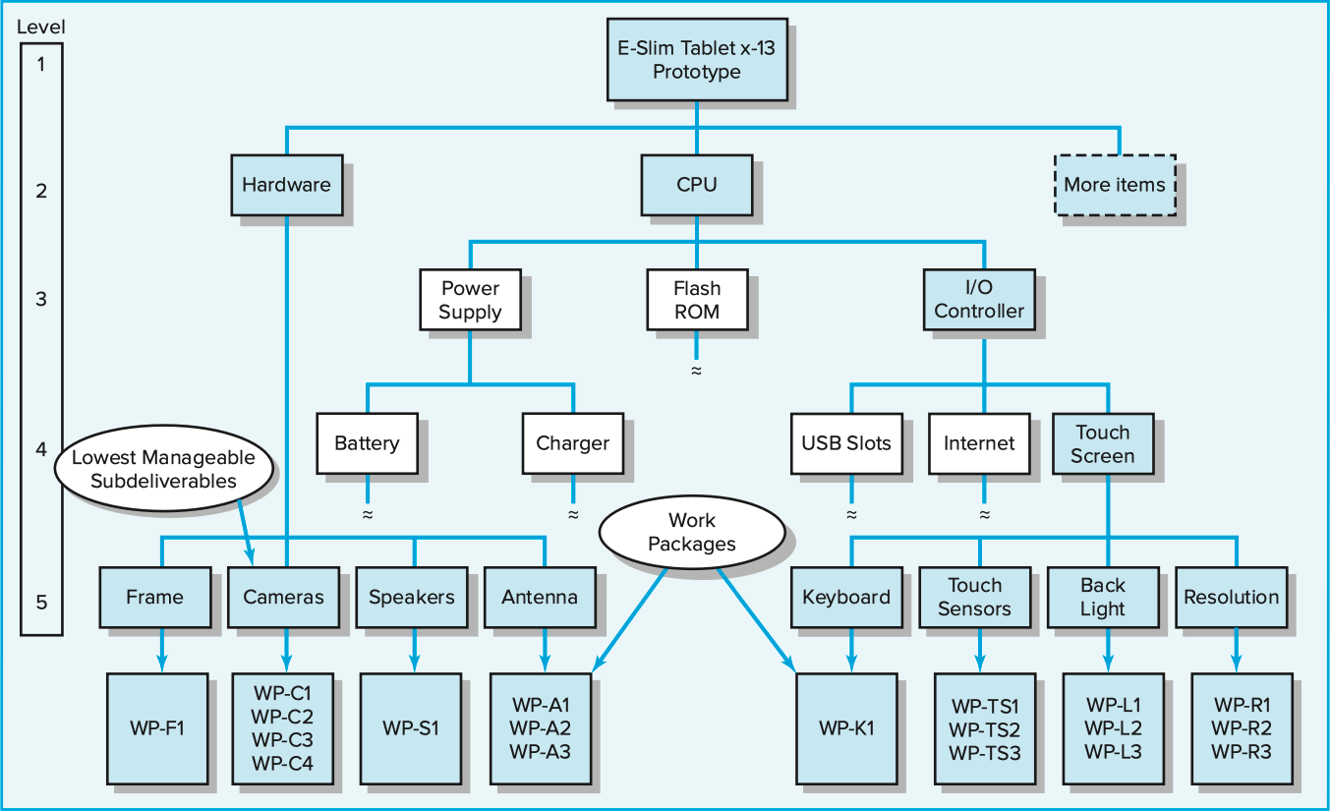
Example 3:

Slide 32
3- Creating the Work Breakdown Structure (WBS)
Work packages are short- duration tasks that have a definite start and stop point, consume resources, and represent cost.
Each work package is a control point.
A work package manager is responsible for seeing that the package is completed on time, within budget, and according to technical specifications.
Practice suggests a work package should not exceed 10 workdays or one reporting
period.
If a work package has a duration exceeding 10 days, check or monitoring points should be established within the duration, say, every three to five days, so progress and problems can be identified before too much time has passed.
Each work package of the WBS should be as independent of other packages of the
project as possible.
No work package is described in more than one subdeliverable of the WBS.

Slide 33
3- Creating the Work Breakdown Structure (WBS)
The subdeliverable does not have a duration of its own and does not consume resources or cost money directly.
Thus, the work package is the basic unit used for planning, scheduling, and controlling the project
Each work package in the WBS
Work (what)
monitoring points for measuring progress (how well)
Time to complete a work package (how long)
single person responsible for units of work (who)
time-phased budget to complete a work package (cost)
resources needed to complete a work package (how much)

Slide 34
3- Creating the Work Breakdown Structure (WBS)
Project managers should take advantage of relevant examples from previous projects to begin the process
WBSs are products of group efforts
Project teams developing their first WBS frequently forget that the structure should be end-item, output oriented.
First attempts often result in a WBS that follows the organization structure—design, marketing, production, finance. So, every effort should be made to develop a WBS that is output oriented in order to concentrate on concrete deliverables
WBS should provide the level of detail needed to manage the specific project successfully.

Slide 35
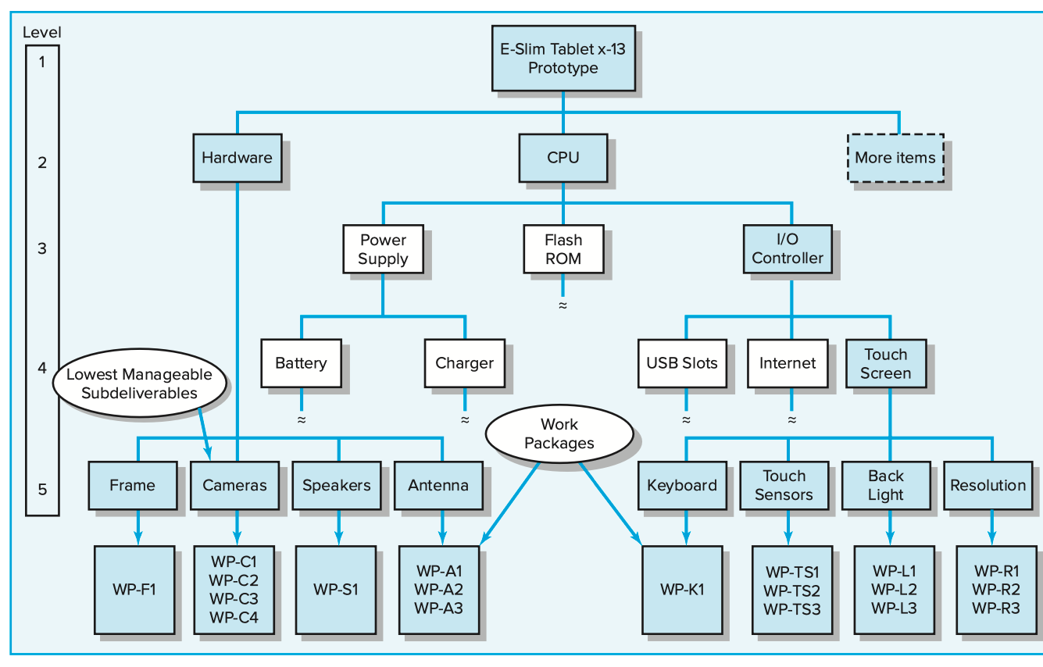
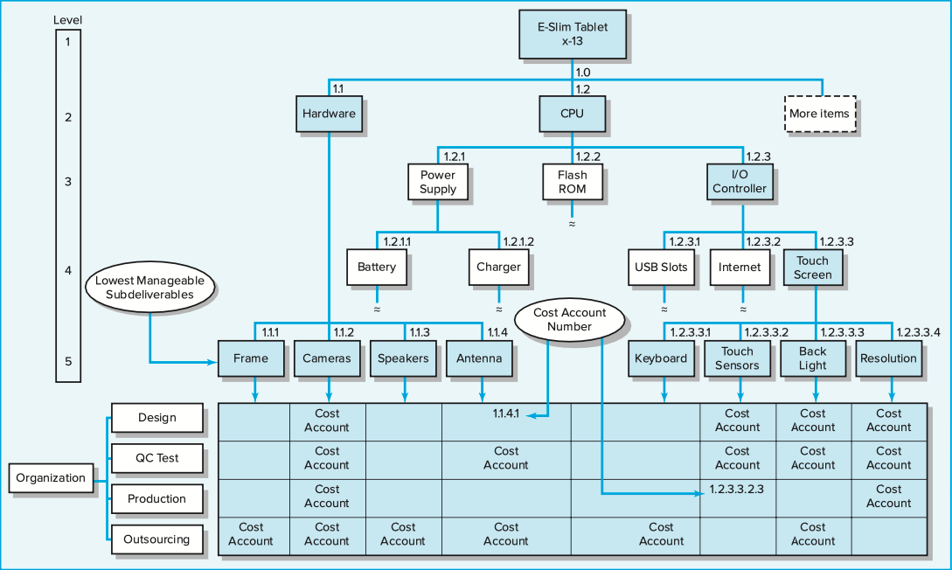
4- Integrating the WBS with the Organization (1/2)

Slide 36
4- Integrating the WBS with the Organization (2/2)
The WBS is used to link the organizational units responsible for performing the work. In practice, the outcome of this process is the organization breakdown structure (OBS)
The OBS depicts how the firm has organized to discharge work responsibility.
The purposes of the OBS are to provide a framework to summarize organization unit work performance, identify organization units responsible for work packages, and tie the organizational unit to cost control accounts.
The intersection of work packages and the organizational unit creates a project control point (cost account) that integrates work and responsibility
In the execution phase of the project, progress can be tracked vertically on deliverables (client’s interest) and tracked horizontally by organization responsibility (owner’s interest).
16

Slide 37
5- Coding the WBS for the Information System (1/2)
Gaining the maximum usefulness of a breakdown structure depends on a coding system.
The codes are used to define levels and elements in the WBS, organization elements, work packages, and budget and cost information.
The codes allow reports to be consolidated at any level in the structure. The most
commonly used scheme in practice is numeric indention; knowing that the
project identification is 1.0
All tasks and elements in the structure have an identification code.
The “cost account” is the focal point because all budgets, work assignments, time, cost, and technical performance come together at this point.
This coding system can be extended to cover large projects. Additional schemes
can be added for special reports. For example, adding a “23” after the code could
indicate a site location, an elevation, or a special account such as labor. Some
letters can be used as special identifiers such as “M” for materials or “E” for engineers
17

Slide 38
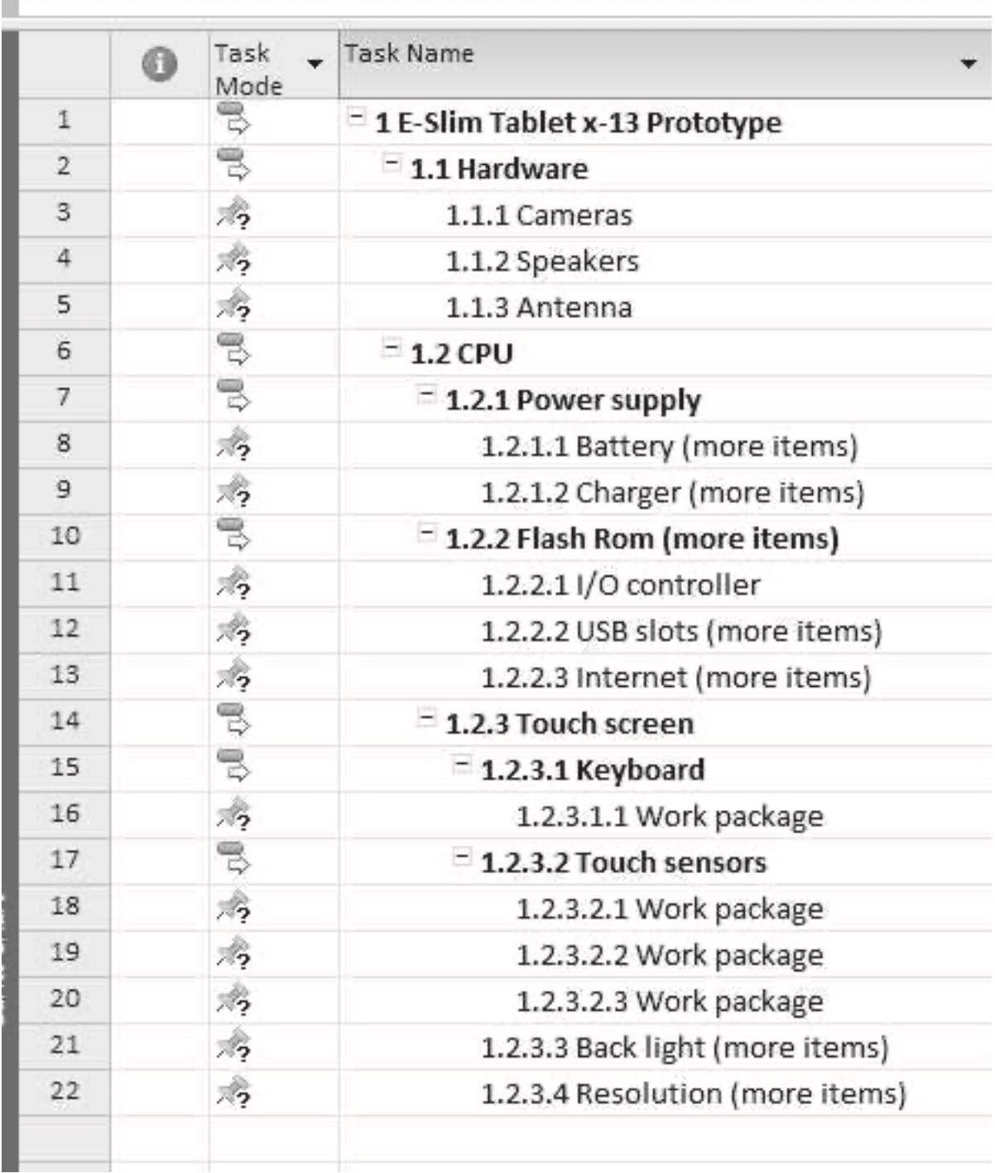
5- Coding the WBS for the Information System (2/2)
You are not limited to only 10 subdivisions (0–9)
For example, for a large, complex project: 3R−237A−P2−33.6; where 3R identifies the facility, 237A
represents elevation and the area, P2 represents pipe two inches wide, and 33.6 represents the work package
number. In practice most organizations are creative in combining letters and numbers to minimize the length of WBS codes.
On larger projects, the WBS is further supported with a WBS dictionary that provides detailed information about each element in the WBS. The dictionary typically includes the work package level (code), name, and functional description. In some cases, the description is supported with specifications. The availability of detailed descriptions has an added benefit of dampening scope creep.
18

Slide 39
Responsibility Matrices (1/3)
In many cases, the size and scope of the project do not warrant an elaborate WBS or OBS. One tool that is widely used by project managers and task force leaders of small projects is the responsibility matrix (RM); (sometimes called a linear responsibility chart)
It summarizes the tasks to be accomplished and who is responsible for what on a project.
In its simplest form an RM consists of a chart listing all the project activities and the participants responsible for each activity
By using an RM and by defining authority, responsibility, and communications within its framework, the relationship between different organizational units and the work content of the project is made clear
19

Slide 40
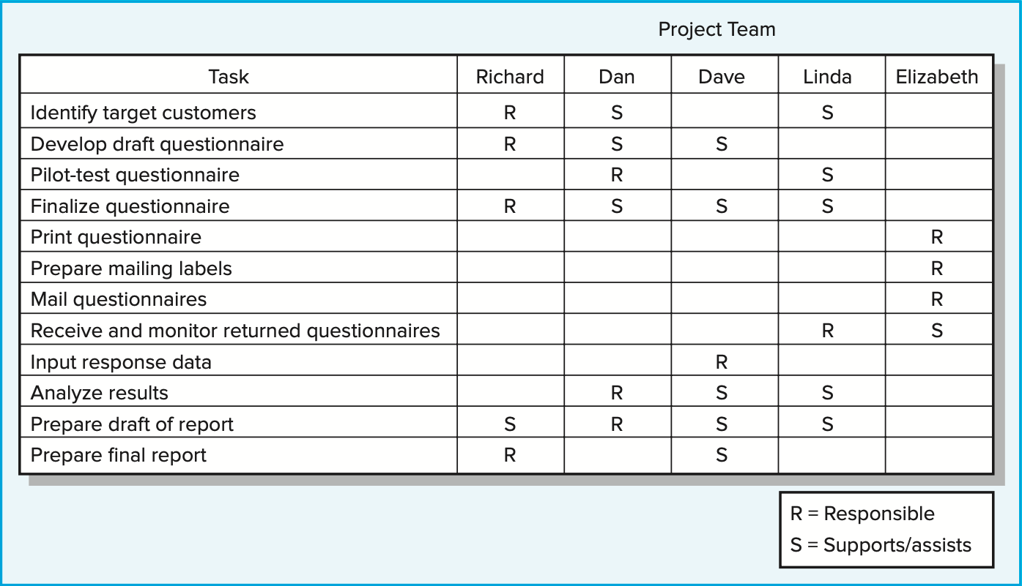
Responsibility Matrices (2/3)
Example for an RM for a simple market research study
20

Slide 41
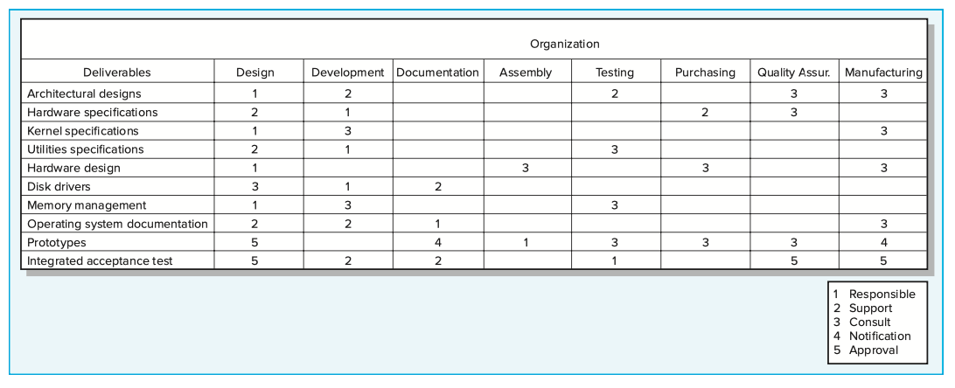
Responsibility Matrices (3/3)
Example for an RM for a large, complex project to develop a new piece of automated equipment
21

Slide 42
Project Communication Plan (1/6)
Once the project deliverables and work are clearly identified, an internal communication plan is vital as the next step.
Poor communication is a major contributor to project failure
The communication plan is usually created by the project manager and/or the project team in the early stage of project planning
The plan maps out the flow of information to different stakeholders and becomes an integral part of the overall project plan
The purpose of a project communication plan is to express what, who, how, and when information will be transmitted to project stakeholders so schedules, issues, and action items can be tracked

Slide 43
Project Communication Plan (2/6)
Project communication plans address the following core questions:
What information needs to be collected and when?
Who will receive the information?
What methods will be used to gather and store information?
What are the limits, if any, on who has access to certain kinds of information?
When will the information be communicated?
How will it be communicated?

Slide 44
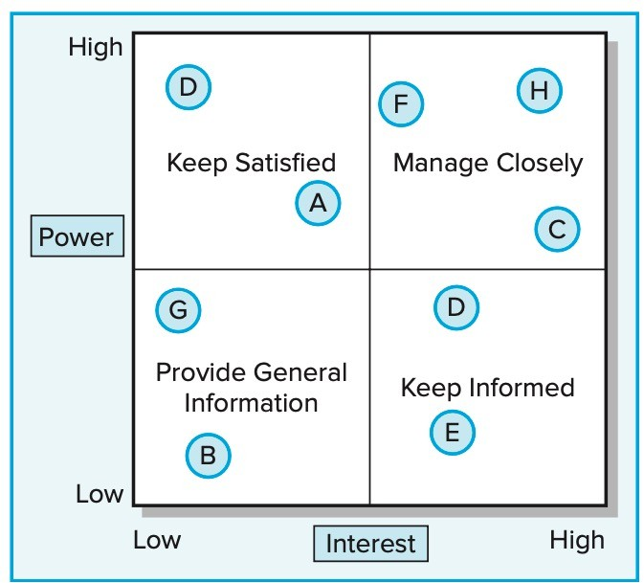
Project Communication Plan (3/6)
Developing a communication plan usually includes the following steps:
  Stakeholder analysis: Identify the target groups. A common tool found in practice to initially identify and analyze major project stakeholders’ communication needs is:

Slide 45
Project Communication Plan (4/6)
2. Information needs: What information is closely related to stakeholders who contribute to the project’s progress? The simplest answer to this question can be obtained by asking the different people what information they need and when they need it. Frequent information needs found in communication plans are:
Project status reports Changes in scope Gating decisions Action items
Deliverable issues
Team status meetings Accepted request changes Milestone reports
3. Sources of information: When the information needs are identified, the next step is to determine the sources of information. That is, where does the information reside? How will it be collected? For example, information relating to the milestone report, team meetings, and project status meetings would be found in the minutes and reports of various groups.
25

Slide 46
Project Communication Plan (5/6)
Dissemination modes: In today’s world, traditional status report meetings are being supplemented by e-mail, teleconferencing, ….. In particular, many companies are using the Web to create a “virtual project office” to store project information. In some cases, appropriate information is routed automatically to key stakeholders. Backup paper hardcopy to specific stakeholders is still critical for many project changes and action items.
Responsibility and timing: Determine who will send out the information. For example, a common practice is to have secretaries of meetings forward the minutes or specific information to the appropriate stakeholders. In some cases, the responsibility lies with the project manager or project office. Timing and frequency of distribution appropriate to the information need to be established.

Slide 47
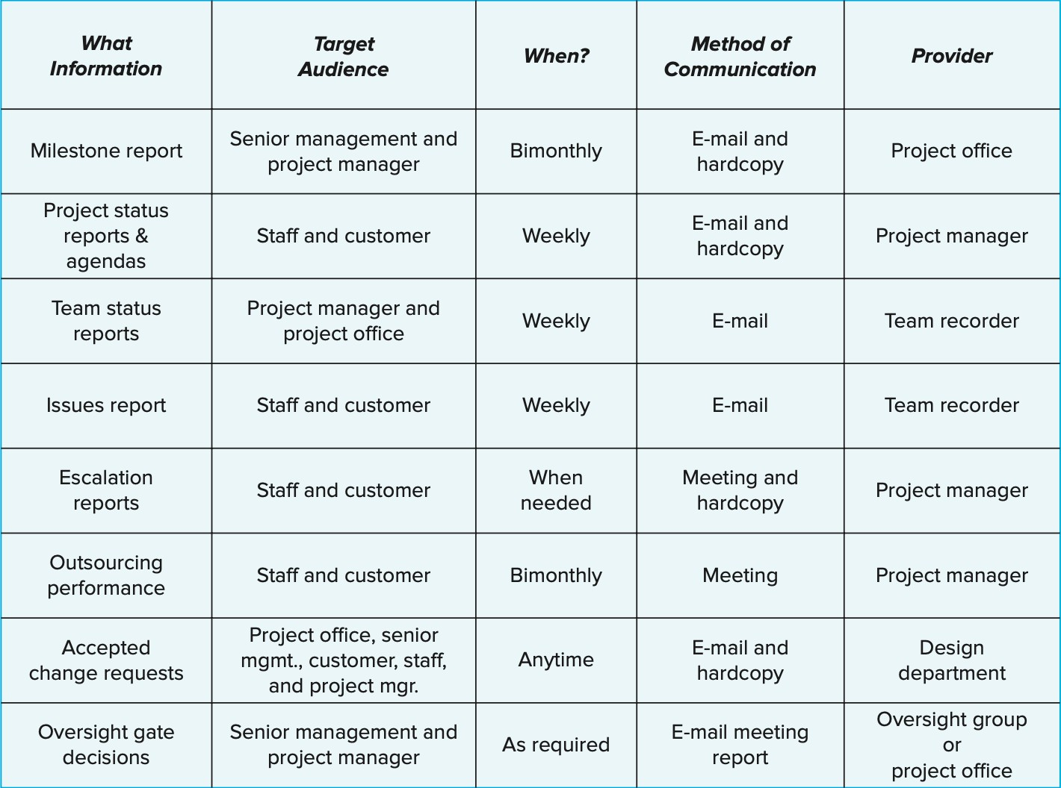
Project Communication Plan (6/6)
Example: Shale Oil Research Project Communication Plan

Slide 48
Assignement 3
What does it mean if the priorities of a project include: Time- constrain, Scope- accept, and Cost-enhance?
What kinds of information are included in a work package?
When would it be appropriate to create a responsibility matrix rather than a full- blown WBS?
How does a communication plan benefit management of projects?
Identify real life examples of a project that would fit each of the following priority scenarios:
a.Time-constrain, Scope-enhance, Cost-accept b.Time-enhance, Scope-constrain, Cost-accept
c. Time-constrain, Scope-accept, Cost-enhance
28

